Slide 1

Chapter 7
Sampling and Sampling Distributions

Slide 2
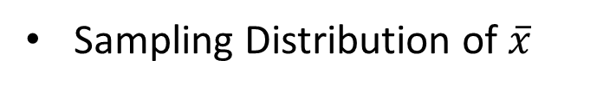
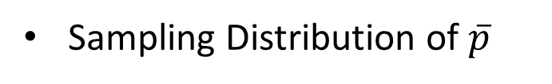
Contents
Selecting a Sample
Point Estimation
Introduction to Sampling Distributions
Sampling Distribution of $\overline{x}$
Sampling Distribution of $\overline{p}$
Other Sampling Methods
Properties of estimators

Slide 3
Introduction
An element is the entity on which data are collected.
A population is a collection of all the elements of interest.
A sample is a subset of the population.
The sampled population is the population from which the sample is drawn.
A frame is a list of the elements that the sample will be selected from.

Slide 4
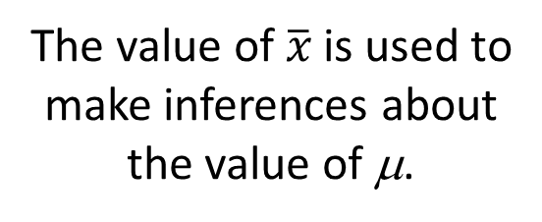


Sampling Distribution of $\overline{x}$
Process of Statistical Inference
Population
Mean μ
is determined
A simple random sample
of n elements is selected
from the population.
The value of $\overline{x}$ is used to
make inferences about
the value of μ.
The sample data
provide a value for
the sample mean $\overline{x}$.

Slide 5
Introduction
The reason we select a sample is to collect data to answer a research question about a population.
The sample results provide only estimates of the values of the population characteristics.
The reason is simply that the sample contains only a portion of the population.
With proper sampling methods, the sample results can provide “good” estimates of the population characteristics.

Slide 6
Selecting a Sample
Sampling from a Finite Population
Sampling from an Infinite Population

Slide 7
Sampling from a Finite Population
Finite populations are often defined by lists such as:
Organization membership roster
Credit card account numbers
Inventory product numbers
A simple random sample of size n from a finite population of size N is a sample selected such that each possible sample of size n has the same probability of being selected.

Slide 8
Sampling from a Finite Population
Replacing each sampled element before selecting subsequent elements is called sampling with replacement. An element can appear in the sample more than once.
Sampling without replacement is the procedure used most often.
In large sampling projects, computer-generated random numbers are often used to automate the sample selection process.

Slide 9
Sampling from a Finite Population
Example: St. Andrew’s College
St. Andrew’s College received 900 applications for admission in the upcoming year from prospective students. The applicants were numbered, from 1 to 900, as their applications arrived. The Director of Admissions would like to select a simple random sample of 30 applicants.

Slide 10
Sampling from a Finite Population
Example: St. Andrew’s College
Step 1: Assign a random number to each of the 900 applicants.
The random numbers generated by Excel’s RAND function follow a uniform probability distribution between 0 and 1.
Step 2: Select the 30 applicants corresponding to the 30 smallest random numbers.

Slide 11
Sampling from an Infinite Population
Sometimes we want to select a sample, but find that it is not possible to obtain a list of all elements in the population.
As a result, we cannot construct a frame for the population.
Hence we cannot use the random number selection procedure.
Most often this situation occurs in the case of infinite population.

Slide 12
Sampling from an Infinite Population
Populations are often generated by an ongoing process where there is no upper limit on the number of units that can be generated.
Some examples of on-going processes with infinite populations are:
parts being manufactured on a production line
transactions occurring at a bank
telephone calls arriving at a technical help desk
customers entering a store

Slide 13
Sampling from an Infinite Population
In the case of an infinite population, we must select a random sample in order to make valid statistical inferences about the population from which the sample is taken.
A random sample from an infinite population is a sample selected such that the following conditions are satisfied.
Each element selected comes from the population of interest.
Each element is selected independently.

Slide 14
Point Estimation
Point estimation is a form of statistical inference.
In point estimation we use the data from the sample to compute a value of a sample statistic that serves as an estimate of a population parameter.
We refer to $\overline{x}$ as the point estimator of the population mean μ.
s is the point estimator of the population standard deviation σ.
$\overline{p}$ is the point estimator of the population proportion p.

Slide 15
Point Estimation
Example: St. Andrew’s College
Recall that St. Andrew’s College received 900 applications from prospective students. The application form contains a variety of information including the individual’s Scholastic Aptitude Test (SAT) score and whether or not the individual desires on-campus housing.
At a meeting in a few hours, the Director of Admissions would like to announce the average SAT score and the proportion of applicants that want to live on campus, for the population of 900 applicants.

Slide 16
Point Estimation
Example: St. Andrew’s College
However, the necessary data on the applicants have not yet been entered in the college’s computerized database. So, the Director decides to estimate the values of the population parameters of interest based on sample statistics. The sample of 30 applicants is selected using computer-generated random numbers.

Slide 17
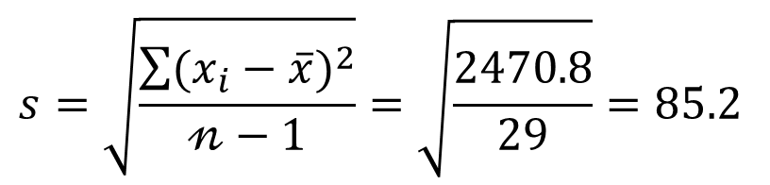
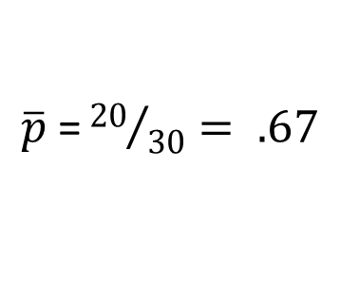
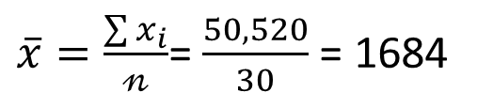
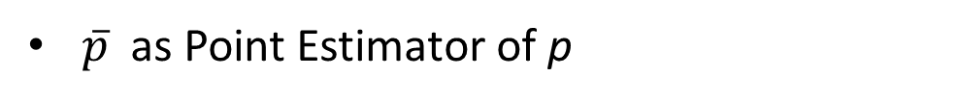
Point Estimation
$\overline{x}$ as Point Estimator of μ
$\overline{x}=\frac{\sum{x_{i}}}{𝓃}$= $\frac{50,520}{30}$ = 1684
s as Point Estimator of σ
$$s=\sqrt{\frac{\sum{(x_{i}−\overline{x})^{2}}}{𝓃−1}}=\sqrt{\frac{2470.8}{29}}=85.2$$
$\overline{p}$as Point Estimator of p
$\overline{p}$ =${ 20}/{30}= .67$
Note: Different random numbers would have identified a different sample which would have resulted in different point estimates.

Slide 18
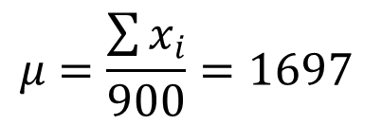
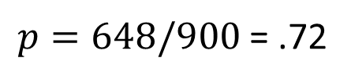
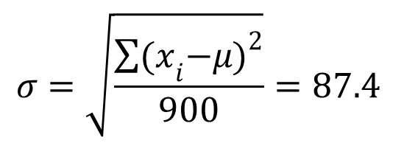
Point Estimation
Once all the data for the 900 applicants were entered in the database of the college , the values of the population parameters of interest were calculated.
Population Mean SAT Score
$$μ=\frac{\sum{x_{i}}}{900}=1697$$
Population Standard Deviation for SAT Score
$$σ=\sqrt{\frac{\sum{{(x}_{i}−μ)^{2}}}{900}}=87.4$$
Population proportion wanting On-Campus Housing
$p=648/900$ = .72

Slide 19
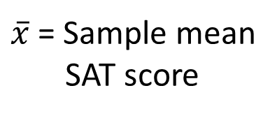
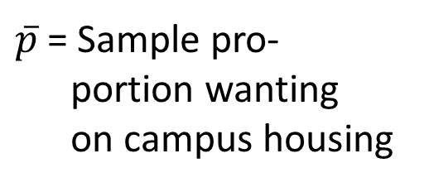
Summary of Point Estimates
Obtained from a Simple Random Sample
Population
Parameter
Parameter
Value
Point
Estimator
Point
Estimate
μ = Population mean
SAT score
1697
$\overline{x}$ = Sample mean
SAT score
1684
σ = Population std.
deviation for
SAT score
87.4
s = Sample std.
deviation
for SAT score
85.2
p = Population pro-
portion wanting
campus housing
.72
$\overline{p}$ = Sample pro-
portion wanting
on campus housing
.67

Slide 20
Practical Advice
The target population is the population we want to make inferences about.
The sampled population is the population from which the sample is actually taken.
Whenever a sample is used to make inferences about a population, we should make sure that the targeted population and the sampled population are in close agreement.

Slide 21

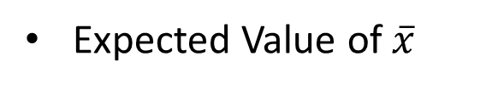
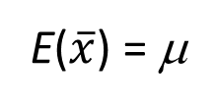
Sampling Distribution of $\overline{x}$
The sampling distribution of $\overline{x}$ is the probability distribution of all possible values of the sample mean $\overline{x}$.
Expected Value of $\overline{x}$
E($\overline{x}$) = μ
where: μ = the population mean
When the expected value of the point estimator equals the population parameter, we say the point estimator is unbiased.
It is a theoretical data, we do not actually build it.

Slide 22
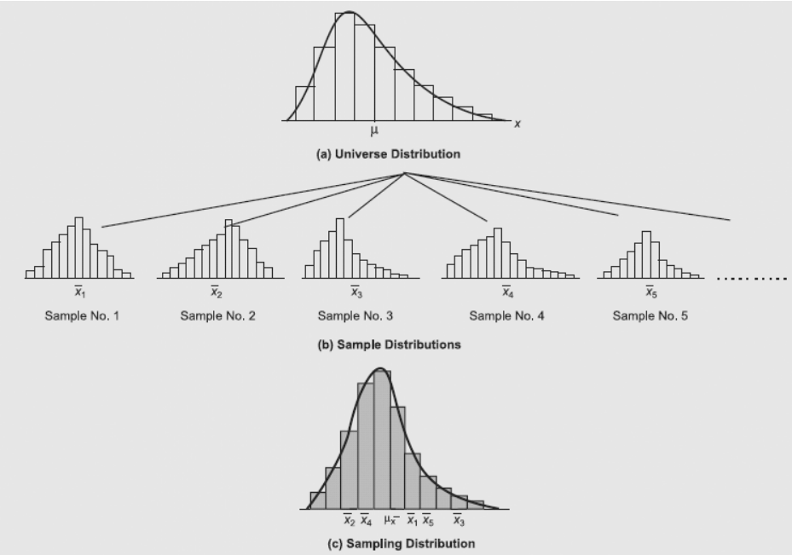

Sampling Distribution of $\overline{x}$

Slide 23
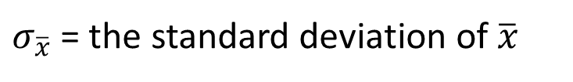
Sampling Distribution of $\overline{x}$
We will use the following notation to define the standard deviation of the sampling distribution of $\overline{x}$.
$σ_{\overline{x}}$ = the standard deviation of $\overline{x}$
σ = the standard deviation of the population
n = the sample size
N = the population size

Slide 24
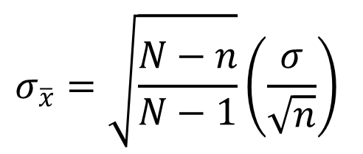
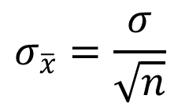
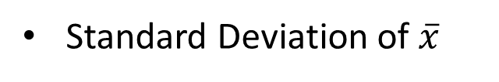
Sampling Distribution of $\overline{x}$
Standard Deviation of $\overline{x}$
Finite Population
Infinite Population
$$σ_{\overline{x}}=\sqrt{\frac{N−n}{N−1}}\left(\frac{σ}{\sqrt{n}}\right)$$
$$σ_{\overline{x}}=\frac{σ}{\sqrt{n}}$$
A finite population is treated as being infinite if n/N < .05.
$\sqrt{(N−n)/(N−1)}$ is the finite population correction factor.
$σ_{\overline{x}}$ is referred to as the standard error of the mean.

Slide 25
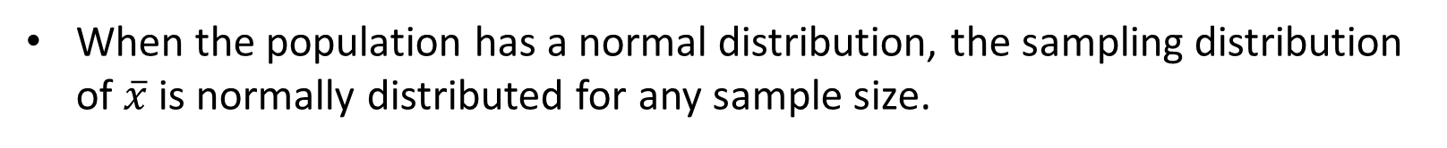
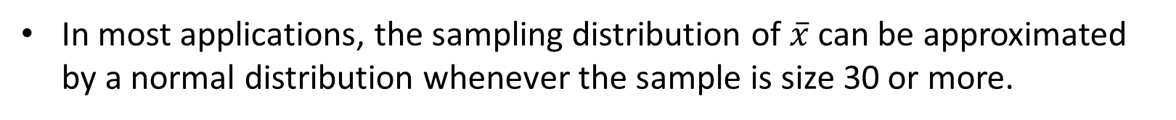
Sampling Distribution of $\overline{x}$
When the population has a normal distribution, the sampling distribution of $\overline{x}$ is normally distributed for any sample size.
In most applications, the sampling distribution of $\overline{x}$ can be approximated by a normal distribution whenever the sample is size 30 or more.
In cases where the population is highly skewed or outliers are present, samples of size 50 may be needed.
The sampling distribution of $\overline{x}$ can be used to provide probability information about how close the sample mean $\overline{x}$ is to the population mean μ .

Slide 26
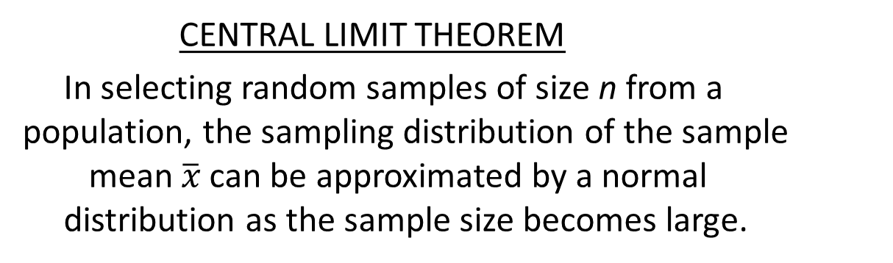

Central Limit Theorem
When the population from which we are selecting a random sample does not have a normal distribution, the central limit theorem is helpful in identifying the shape of the sampling distribution of $\overline{x}$.
CENTRAL LIMIT THEOREM
In selecting random samples of size n from a
population, the sampling distribution of the sample
mean $\overline{x}$ can be approximated by a normal
distribution as the sample size becomes large.

Slide 27
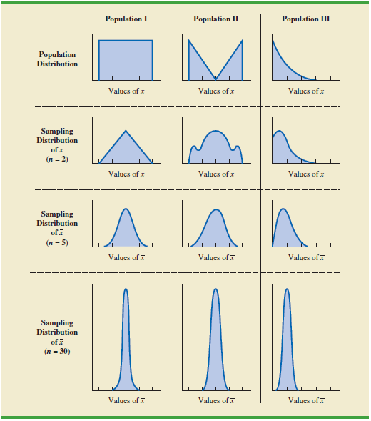
Illustration of Central Limit Theorem

Slide 28

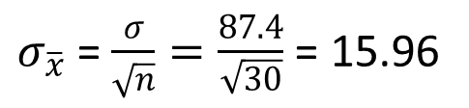


Sampling Distribution of $\overline{x}$
Example: St. Andrew’s College
Sampling
Distribution
of $\overline{x}$ for
SAT Scores
$σ_{\overline{x}}$ =$\frac{σ}{\sqrt{n}}=\frac{87.4}{\sqrt{30}}$ = 15.96
$$\overline{x}$$
$$E\left(\overline{x}\right)=1697$$

Slide 29
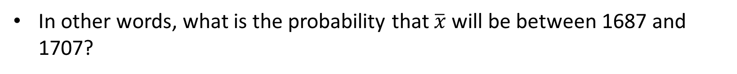
Sampling Distribution of $\overline{x}$
Example: St. Andrew’s College
What is the probability that a simple random sample of 30 applicants will provide an estimate of the population mean SAT score that is within +/-10 of the actual population mean μ ?
In other words, what is the probability that $\overline{x}$ will be between 1687 and 1707?

Slide 30
Sampling Distribution of $\overline{x}$
Example: St. Andrew’s College
Step 1: Calculate the z-value at the upper endpoint of the interval.
z = (1707 - 1697)/15.96 = .63
Step 2: Find the area under the curve to the left of the upper endpoint.
P(z < .63) = .7357

Slide 31

Sampling Distribution of $\overline{x}$
Example: St. Andrew’s College
Cumulative Probabilities for
the Standard Normal Distribution
z
.00
.01
.02
.03
.04
.05
.06
.07
.08
.09
.
.
.
.
.
.
.
.
.
.
.
.5
.6915
.6950
.6985
.7019
.7054
.7088
.7123
.7157
.7190
.7224
.6
.7257
.7291
.7324
.7357
.7389
.7422
.7454
.7486
.7517
.7549
.7
.7580
.7611
.7642
.7673
.7704
.7734
.7764
.7794
.7823
.7852
.8
.7881
.7910
.7939
.7967
.7995
.8023
.8051
.8078
.8106
.8133
.9
.8159
.8186
.8212
.8238
.8264
.8289
.8315
.8340
.8365
.8389
.
.
.
.
.
.
.
.
.
.
.

Slide 32
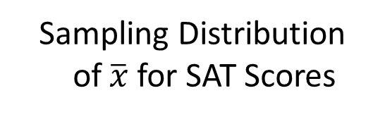

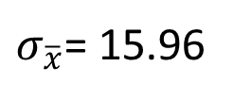
Sampling Distribution of $\overline{x}$
Example: St. Andrew’s College
Sampling Distribution
of $\overline{x}$ for SAT Scores
$σ_{\overline{x}}$= 15.96
Area = .7357
$$\overline{x}$$
1697
1707

Slide 33
Sampling Distribution of $\overline{x}$
Example: St. Andrew’s College
Step 3: Calculate the z-value at the lower endpoint of the interval.
z = (1687 - 1697)/15.96 = - .63
Step 4: Find the area under the curve to the left of the lower endpoint.
P(z < -.63) = .2643

Slide 34


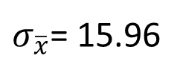
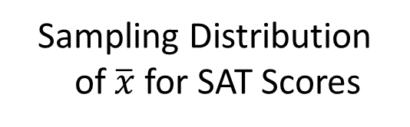
Sampling Distribution of $\overline{x}$ for SAT Scores
Example: St. Andrew’s College
Sampling Distribution
of $\overline{x}$ for SAT Scores
$σ_{\overline{x}}$= 15.96
Area = .2643
$$\overline{x}$$
1687
1697

Slide 35
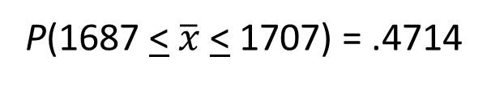
Sampling Distribution of $\overline{x}$ for SAT Scores
Example: St. Andrew’s College
Step 5: Calculate the area under the curve between
the lower and upper endpoints of the interval.
P(-.68 < z < .68) = P(z < .68) - P(z < -.68)
= .7357 - .2643
= .4714
The probability that the estimate of population mean SAT score will be between 1687 and 1707 is:
P(1687 < $\overline{x}$ < 1707) = .4714

Slide 36
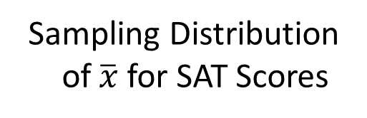

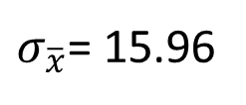
Sampling Distribution of $\overline{x}$ for SAT Scores
Example: St. Andrew’s College
Sampling Distribution
of $\overline{x}$ for SAT Scores
$σ_{\overline{x}}$= 15.96
Area = .4714
$$\overline{x}$$
1687
1697
1707

Slide 37

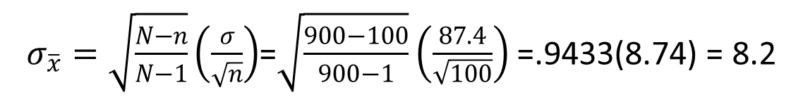
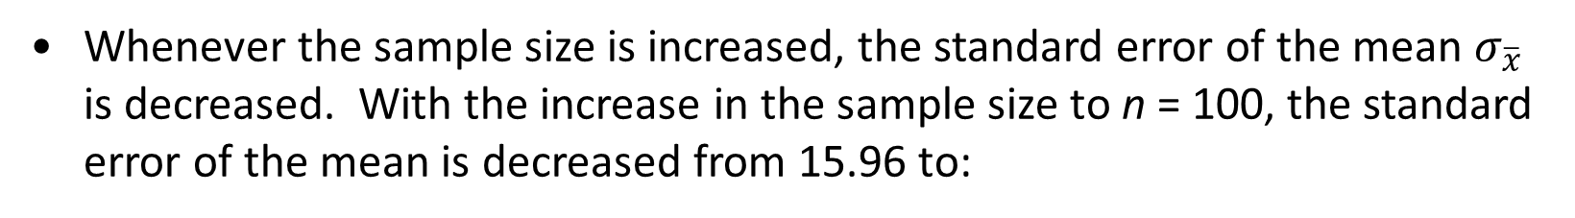
Relationship Between the Sample Size and the Sampling Distribution of $\overline{x}$
Example: St. Andrew’s College
Suppose we select a simple random sample of 100 applicants instead of the 30 originally considered.
E($\overline{x}$) =μ regardless of the sample size. In our example, E($\overline{x}$) remains at 1697.
Whenever the sample size is increased, the standard error of the mean $σ_{\overline{x}}$ is decreased. With the increase in the sample size to n = 100, the standard error of the mean is decreased from 15.96 to:
$σ_{\overline{x}}=\sqrt{\frac{N−n}{N−1}}\left(\frac{σ}{\sqrt{n}}\right)$=$\sqrt{\frac{900−100}{900−1}}\left(\frac{87.4}{\sqrt{100}}\right)$ =.9433(8.74) = 8.2

Slide 38




Relationship Between the Sample Size and the Sampling Distribution of $\overline{x}$
Example: St. Andrew’s College
With n = 100,
$$σ_{\overline{x}}=8.2$$
With n = 30,
$$σ_{\overline{x}}=15.96$$
$$\overline{x}$$
$$E\left(\overline{x}\right)=1697$$

Slide 39
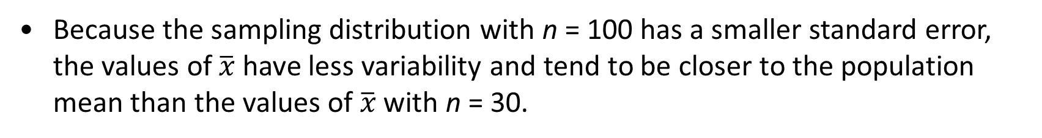

Relationship Between the Sample Size and the Sampling Distribution of $\overline{x}$
Example: St. Andrew’s College
Recall that when n = 30, P(1687 < $\overline{x}$ < 1707) = .4714.
We follow the same steps to solve for P(1687 < $\overline{x}$ < 1707) when n = 100 as we showed earlier when n = 30.
Now, with n = 100, P(1687 < $\overline{x}$ < 1707) = .7776.
Because the sampling distribution with n = 100 has a smaller standard error, the values of $\overline{x}$ have less variability and tend to be closer to the population mean than the values of $\overline{x}$ with n = 30.

Slide 40



Relationship Between the Sample Size
and the Sampling Distribution of $\overline{x}$
Example: St. Andrew’s College
Sampling Distribution
of $\overline{x}$ for SAT Scores
$$σ_{\overline{x}}=8.2$$
Area = .7776
$$\overline{x}$$
1687
1697
1707

Slide 41
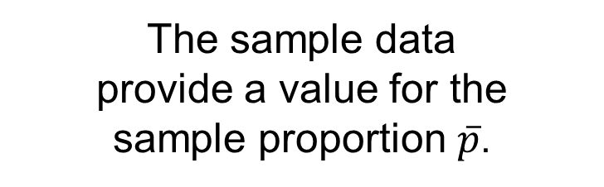
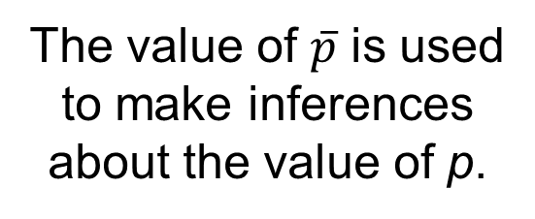
Sampling Distribution of $\overline{p}$
Making Inferences about a Population Proportion
Population
with proportion
p = ?
A simple random sample
of n elements is selected
from the population.
The value of $\overline{p}$ is used
to make inferences
about the value of p.
The sample data
provide a value for the
sample proportion $\overline{p}$.

Slide 42

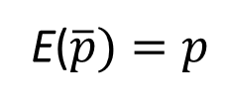
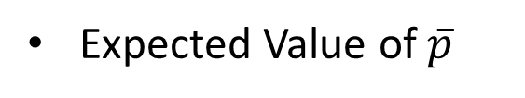
Sampling Distribution of $\overline{p}$
The sampling distribution of $\overline{p}$ is the probability distribution of all possible values of the sample proportion $\overline{p}$.
Expected Value of $\overline{p}$
E($\overline{p})=p$
where: p = the population proportion

Slide 43
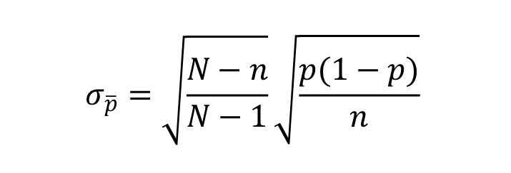
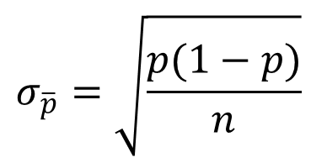
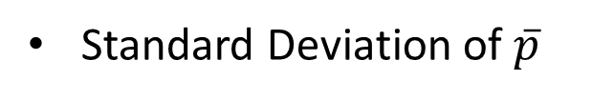
Sampling Distribution of $\overline{p}$
Standard Deviation of $\overline{p}$
Finite Population
Infinite Population
$$σ_{\overline{p}}=\sqrt{\frac{N−n}{N−1}}\sqrt{\frac{p(1−p)}{n}}$$
$$σ_{\overline{p}}=\sqrt{\frac{p(1−p)}{n}}$$
$σ_{\overline{p}}$ is referred to as the standard error of the proportion.
$\sqrt{(N−n)/(N−1)}$ is the finite population correction factor.

Slide 44
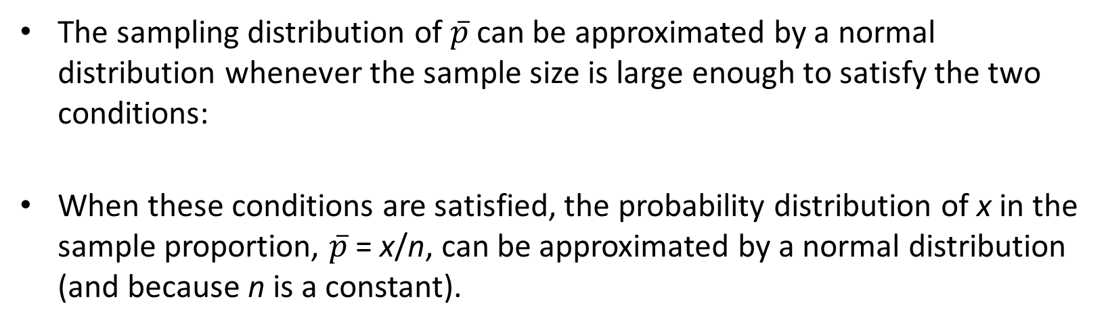
Sampling Distribution of $\overline{p}$
The sampling distribution of $\overline{p}$ can be approximated by a normal distribution whenever the sample size is large enough to satisfy the two conditions:
When these conditions are satisfied, the probability distribution of x in the sample proportion, $\overline{p}$ = x/n, can be approximated by a normal distribution (because n is a constant).
np > 5 and n(1 – p) > 5
43

Slide 45
Sampling Distribution of $\overline{p}$
Example: St. Andrew’s College
Recall that 72% of the prospective students applying to St. Andrew’s College desire on-campus housing.
What is the probability that a simple random sample of 30 applicants will provide an estimate of the population proportion of applicant desiring on-campus housing that is within plus or minus .05 of the actual population proportion?

Slide 46
Sampling Distribution of $\overline{p}$
Example: St. Andrew’s College
For our example, with n = 30 and p = .72, the normal distribution is an acceptable approximation because:
np = 30(.72) = 21.6 > 5
and
n(1 - p) = 30(.28) = 8.4 > 5

Slide 47
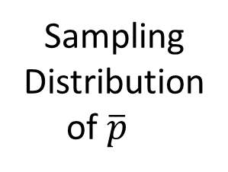
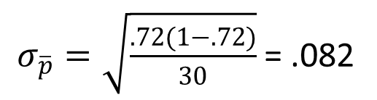


Sampling Distribution of $\overline{p}$
Example: St. Andrew’s College
Sampling
Distribution
of $\overline{p}$
$σ_{\overline{p}}=\sqrt{\frac{.72(1−.72)}{30}}$ = .082
$$\overline{p}$$
$$E\left(\overline{p}\right)=.72$$

Slide 48
Sampling Distribution of $\overline{p}$
Example: St. Andrew’s College
Step 1: Calculate the z-value at the upper endpoint of the interval.
z = (.77 - .72)/.082 = .61
Step 2: Find the area under the curve to the left of the upper endpoint.
P(z < .61) = .7291
Step 3: Calculate the z-value at the lower endpoint of the interval.
z = (.67 - .72)/.082 = - .61
Step 4: Find the area under the curve to the left of the lower endpoint.
P(z < -.61) = .2709

Slide 49
Sampling Distribution of $\overline{p}$
Example: St. Andrew’s College
Cumulative Probabilities for
the Standard Normal Distribution
z
.00
.01
.02
.03
.04
.05
.06
.07
.08
.09
.
.
.
.
.
.
.
.
.
.
.
.5
.6915
.6950
.6985
.7019
.7054
.7088
.7123
.7157
.7190
.7224
.6
.7257
.7291
.7324
.7357
.7389
.7422
.7454
.7486
.7517
.7549
.7
.7580
.7611
.7642
.7673
.7704
.7734
.7764
.7794
.7823
.7852
.8
.7881
.7910
.7939
.7967
.7995
.8023
.8051
.8078
.8106
.8133
.9
.8159
.8186
.8212
.8238
.8264
.8289
.8315
.8340
.8365
.8389
.
.
.
.
.
.
.
.
.
.
.

Slide 50



Sampling Distribution of $\overline{p}$
Example: St. Andrew’s College
Sampling
Distribution
of $\overline{p}$
$σ_{\overline{p}}$= .082
Area = .7291
$$\overline{p}$$
.72
.77

Slide 51



Sampling Distribution of $\overline{p}$
Example: St. Andrew’s College
Sampling
Distribution
of $\overline{p}$
$σ_{\overline{p}}$= .082
Area = .2709
$$\overline{p}$$
.67
.72

Slide 52

Sampling Distribution of $\overline{p}$
Example: St. Andrew’s College
Step 5: Calculate the area under the curve between the lower and upper endpoints of the interval.
P(-.61 < z < .61) = P(z < .61) - P(z < -.61)
= .7291 - .2709
= .4582
The probability that the estimate of the population proportion of applicants desiring on-campus housing is within plus or minus . 05 of the actual population proportion :
P(.67 < $\overline{p}$ < .77) = .4582

Slide 53



Sampling Distribution of $\overline{p}$
Example: St. Andrew’s College
Sampling
Distribution
of $\overline{p}$
$σ_{\overline{p}}$= .082
Area = .4582
$$\overline{p}$$
.67
.72
.77

Slide 54
Other Sampling Methods
Stratified Random Sampling
Cluster Sampling
Systematic Sampling
Convenience Sampling
Judgment Sampling

Slide 55

Properties of Point Estimators
If the expected value of the sample statistics is equal to the population parameter being estimated, the sample statistics is said to be an unbiased estimator of the population parameter.

Slide 56

Properties of Point Estimators

Slide 57

Properties of Point Estimators
Given the choice of two unbiased estimators of the same population parameter, we would prefer to use the point estimator with the smaller standard deviation, since it tends to provide estimates closer to the population parameter.

Slide 58
Properties of Point Estimators
The point estimator with the smaller standard deviation is said to have greater relative efficiency than the other.
A point estimator is consistent if the values of the point estimator tend to become closer to the population parameter as the sample size becomes larger.

Slide 59
Recommendation
It is recommended that probability sampling methods (simple random, stratified, cluster, or systematic) be used.
For these methods, formulas are available for evaluating the “goodness” of the sample results in terms of the closeness of the results to the population parameters being estimated.
An evaluation of the goodness cannot be made with non-probability (convenience or judgment) sampling methods.

Slide 60
Sampling Distribution – Question for Practice
The mean preparation fee H&R Block charged retail customers last year was $183
(Wall Street Journal, March 7, 2012). Use this price as the population mean and
assume the population standard deviation of preparation fees is $50.
a. What is the probability that the mean price for a sample of 30 H&R Block retail
customers is within $8 of the population mean?
b. What is the probability that the mean price for a sample of 50 H&R Block retail
customers is within $8 of the population mean?
c. What is the probability that the mean price for a sample of 100 H&R Block retail
customers is within $8 of the population mean?
d. Which, if any, of the sample sizes in parts (a), (b), and (c) would you recommend to have at least a .95 probability that the sample mean is within $8 of the population mean?

Slide 61
Sampling Distribution – Question for Practice
Forty-two percent of primary care doctors think their patients receive unnecessary medical care (Reader’s Digest, December 2011/January 2012).
a. Suppose a sample of 300 primary care doctors were taken. Show the sampling
distribution of the proportion of the doctors who think their patients receive unnecessary medical care.
b. What is the probability that the sample proportion will be within ±.03 of the population proportion?
c. What is the probability that the sample proportion will be within ±.05 of the population proportion?
d. What would be the effect of taking a larger sample on the probabilities in parts (b) and (c)? Why?

Slide 62
End of Chapter 7

